Slide 1


CS-3002: Information Security
Lecture # 4: Block Ciphers
Prof. Dr. Sufian Hameed
Department of Computer Science
FAST-NUCES

Slide 2
Block Cipher

Slide 3
Modern Ciphers
Modern ciphers
Sophisticated design using substitutions and permutations
Round-based encryption and decryption algorithms
Efficient implementations in hardware and software
Common classes of modern ciphers
Block ciphers = processing of fixed-length blocks
Examples: DES, AES, Blowfish
Stream ciphers = processing of individual bits or bytes
Examples: RC4, A5/1

Slide 4
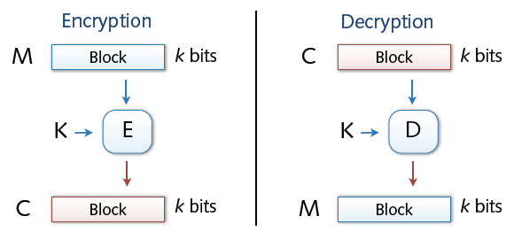
Block Cipher
Encryption and decryption in blocks (e.g., 64 or 128 bit)
Padding of short messages, splitting of long messages
Different modes of operations: ECB, CBC, CTR, ...
Examples:
DES: n= 64 bits, k = 56 bits
3DES: n= 64 bits, k = 168 bits
AES: n=128 bits, k = 128, 192, 256 bits

Slide 5
Block Ciphers Built by Iteration
key k
key expansion
k₁
k₂
k₃
k_{n}
m
R(k₁, ⋅)
R(k₂, ⋅)
R(k₃, ⋅)
R(k_{n}, ⋅)
c
R(k,m) is called a round function
for DES (n=16), 3DES (n=48) and AES-128 (n=10)
Notes:
Typically built on iterations

Slide 6
Design Characteristics for Block Ciphers
Choice of blocklength n
n too long → complex algorithm, performance loss
n too short → weak encryption, easy to attack
Modern variants use n = 128 - 256 bit
Choice of the key length of k
Practical key length: 80 - 256 bit
k too short → systematic testing of all valid keys (Brute Force attack)
Against Brute Force attacks, a minimum of 70-80 bit are necessary

Slide 7
Confusion and Diffusion (Recap)
What makes a cipher secure? Hard to tell
Confusion property
Complex relation between key and plaintext/ciphertext
✸ Hard to deduce key from plaintext/ciphertext pairs
Diffusion property
Complex relation between plaintext and ciphertext
✸ Hard to deduce bits of plaintext from ciphertext

Slide 8
Data Encryption Standard (DES)

Slide 9
The Data Encryption Standard (DES)
Early 1970s: Horst Feistel designs Lucifer at IBM
key-len = 128 bits ; block-len = 128 bits
1973: National Bureau of Standards (NBS) asks for block cipher proposals
IBM submits variant of Lucifer.
1976: NBS adopts DES as a federal standard
key-len = 56 bits ; block-len = 64 bits
Every 5 years:
DES review for decision about further usage
Result: Until now, no modifications were made

Slide 10
The Data Encryption Standard (DES)
Problem of DES:
Usage of a key with a length of 56 bit
Criticized for a key length too short for usage in practice
1997: DES broken by exhaustive search
2000: NIST adopts Rijndael as AES to replace DES

Slide 11
DES Challenge
1997: Internet search -- 3 months
1998: by distributed.net in 41 days in early 1998.
The plaintext was "The secret message is: Many hands make light work.“
1998: Electronic Frontier Foundation (EFF) machine (deep crack) -- 56 hours
The text was revealed to be "The secret message is: It's time for those 128-, 192-, and 256-bit keys.“
1999: combined search -- 22 hours
The plaintext was See you in Rome (second AES Conference, March 22-23, 1999)
⇒ 56-bit ciphers should not be used !! (128-bit key ⇒ 2⁷² days)

Slide 12
DES: core idea – Feistel Network
DES is based on Feistal Network
Consists of invertible function F: {0,1}^{2n} ⟶ {0,1}^{2n}
n-bits
R₀
R₁
R₂
R_{d-1}
R_{d}
f₁
f₂
⋯
f_{d}
L₀
L₁
L₂
L_{d-1}
L_{d}
n-bits
⊕
⊕
⊕
input
output
In symbols:

Slide 13
Inverse of Feistal Function
Feistel network F: {0,1}^{2n} ⟶ {0,1}^{2n} is invertible
R_{i-1}
R_{i}
R_{i-1} = L_{i}
L_{i-1} = f_{i}(L_{i}) ⨁ R_{i}
inverse
f_{i}
L_{i-1}
L_{i}
⊕
R_{i-1}
R_{i}
R_{i}
⊕
R_{i-1}
inverse
f_{i}
L_{i}
f_{i}
L_{i-1}
L_{i-1}
L_{i}
⊕

Slide 14
Decryption circuit
R_{d}
⊕
⊕
⊕
n-bits
R_{d-1}
R_{d-2}
R₁
R₀
⋯
f_{d}
f_{d-1}
f₁
L_{d}
L_{d-1}
L_{d-2}
L₁
L₀
n-bits
Decryption is basically the same Inverted circuit, with f₁, …, f_{d} applied in reverse order

Slide 15
General Structure of DES
DES uses blocks of length n = 64 bit
Length of key k is 56 bit
Encryption takes place in 16 identical rounds with round keys k_{i} of 48 bit length
Encryption process
1. step: permutation performed on the input block
2. step: generation of round keys
3. step: performing 16 identical rounds
4. step: inverse permutation to step 1

Slide 16
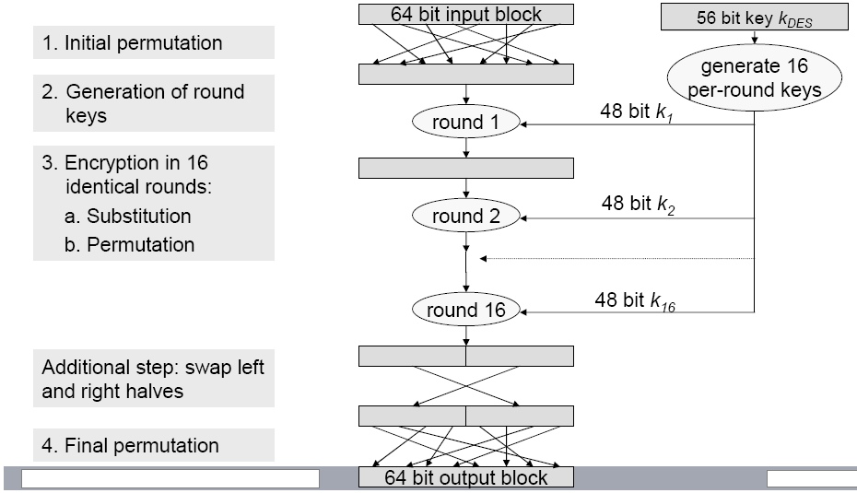
DES Encryption Process

Slide 17
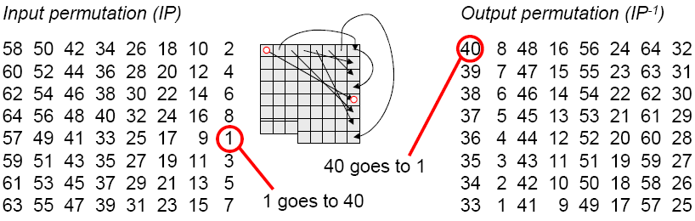
Step 1 & 4: Initial and Final Permutation
Input permutation
See each 64-bit block as 8 Bytes, arranged in a matrix
Diffusion of bits over all bytes
Bits of a column are packed into a row
First byte is spread into 8th bits of all bytes
Second byte is spread into 7th bits of all bytes
...

Slide 18
Step 2: Generation of Round Keys
Preparation: divide K_{DES} into left block (C₀) and right block (D₀) (each 28 bit long - no parity bits) by performing permutations similar to DES initial permutation (which has no security value)
Now: round keys K_{i} are computed in 16 rounds from C_{i} and D_{i}:

Slide 19
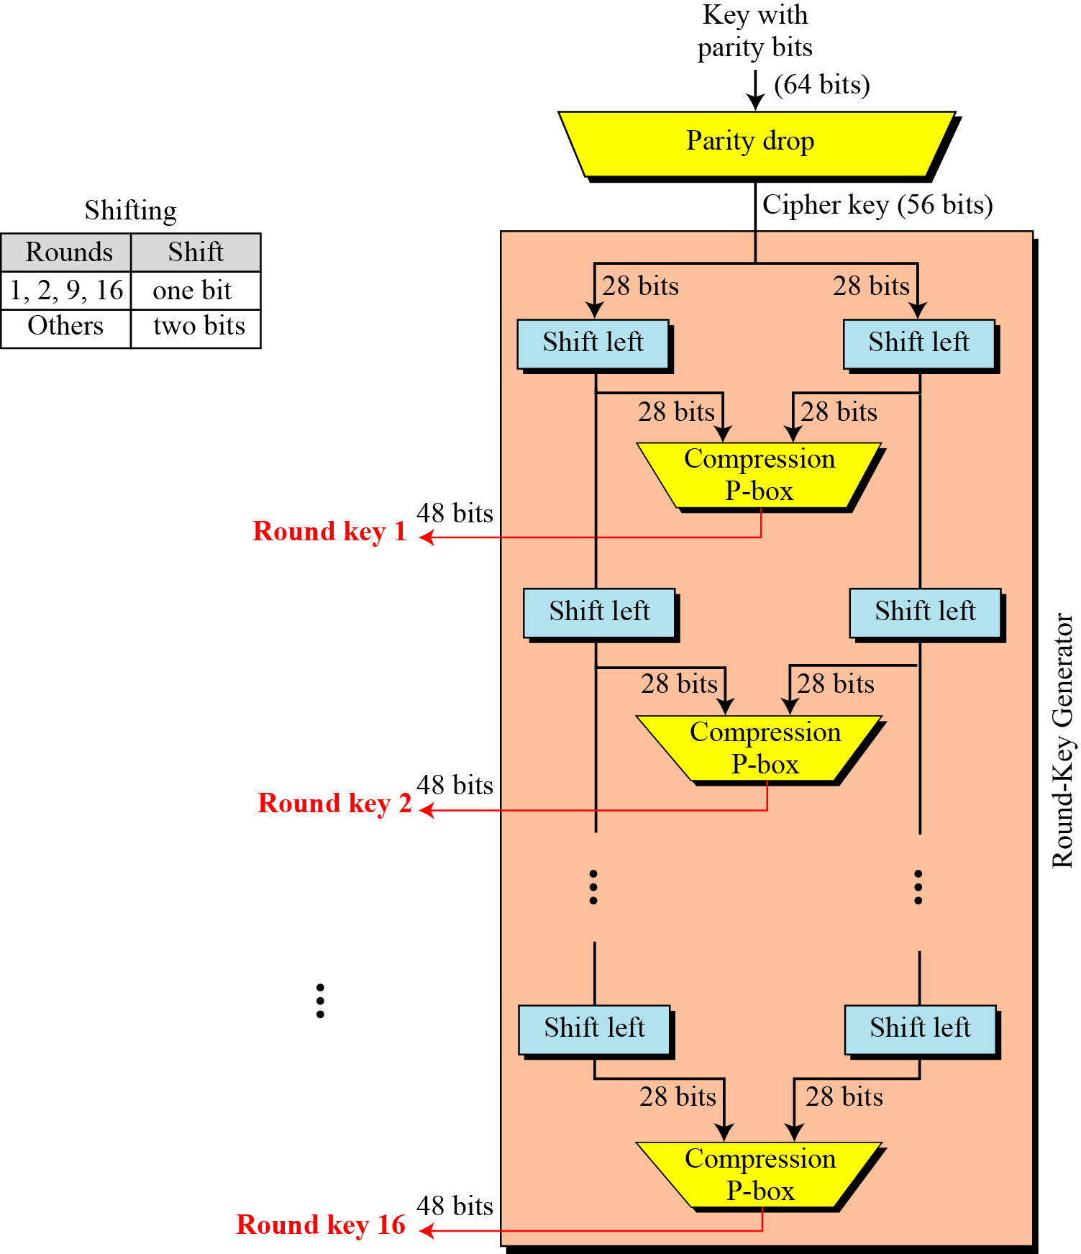
Step 2: Generation of Round Keys

Slide 20
Step 2: Generation of Round Keys
Initial Key permutation and parity bit drop table
Number of bits shift

Slide 21
Step 2: Generation of Round Keys
Characteristics of key generation
Left shift
round 1, 2, 9, and 16: left shift of 1 bit
other rounds: left shift of 2 bits
Notice: 10 years later it was found, that performing the left shift with varying step sizes makes the algorithm more secure
Left half of Ki is only determined by Ci, right side only by Di
Permutations (compression P-box):
perform permutations on remaining bits of Ci and Di to obtain Ki (48 bits)
Ci: bits 9, 18, 22, and 25 are discarded (remaining: 24 bits)
Di: bits 35, 38, 43, and 54 are discarded (remaining: 24 bits)
Notice: the choice of the permutations on Ci and Di influence the security of DES, because they determine the quality of the round keys

Slide 22
Step 2: Generation of Round Keys
Compression P-Box (key compression table)

Slide 23
Step 3: Application of Rounds (16 round Feistel network)
k
key expansion
⋯
k₁
k₂
k₁₆
16 round Feistel network or cipher functions
IP
IP⁻¹
64 bits
64 bits
input
output
To invert, use keys in reverse order

Slide 24
One DES round
Divide input block into two 32-bit blocks Li and Ri
Compute Li+1 as Ri, and Ri+1 as Li ⊕ F(Ri, Ki)
F is cipher function, i.e. combination of substitution and permutation
Security provided by DES depends on the quality of the cipher function
Decryption: uses the same algorithm, has same expense like encryption
R_{i-1}
R_{i}
F_{i}
L_{i-1}
L_{i}
⊕

Slide 25
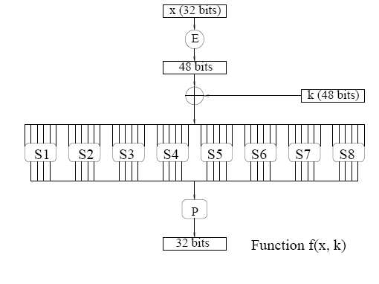
The function F(x, k_{i})
S-box: function {0,1}⁶ ⟶ {0,1}⁴ , implemented as look-up table.
Notes:
E box: bit 1 → bit 2 and 48, bit 2 → bit 3
P Box: bit 1 → bit 9, bit 2 → bit 15

Slide 26
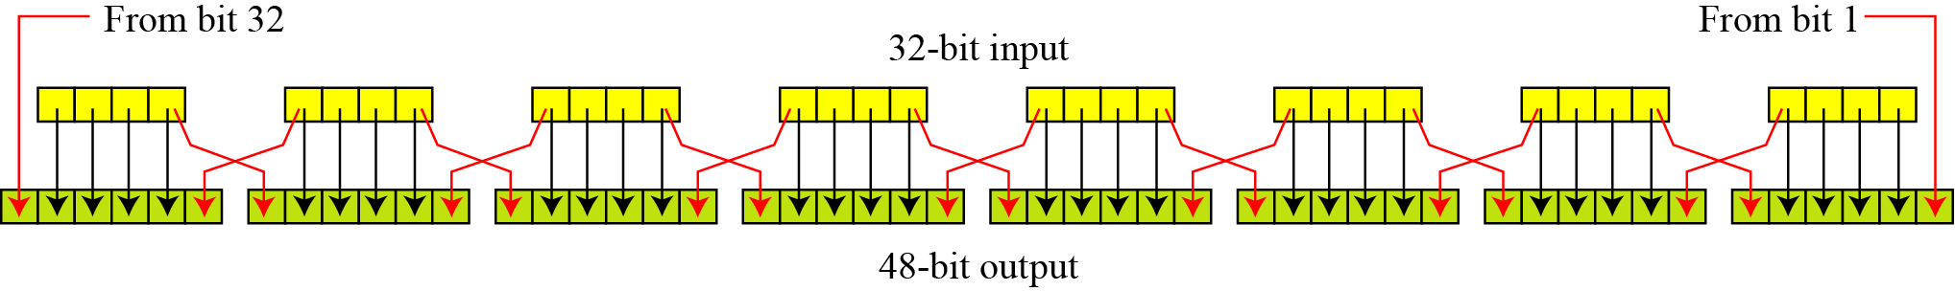
E: Expansion P-box
since R_{i−1} is a 32-bit input and k_{i} is a 48-bit key, we first need to expand R_{i−1} to 48 bits.
Expansion Permutation
Expansion P-Box Table

Slide 27
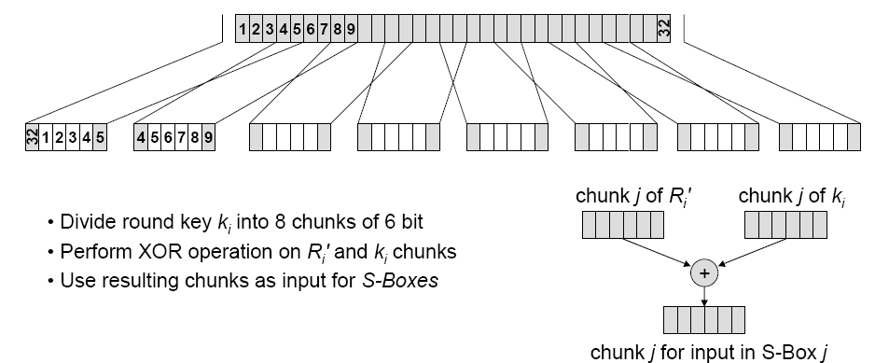
XOR: Key and Expanded R bits

Slide 28
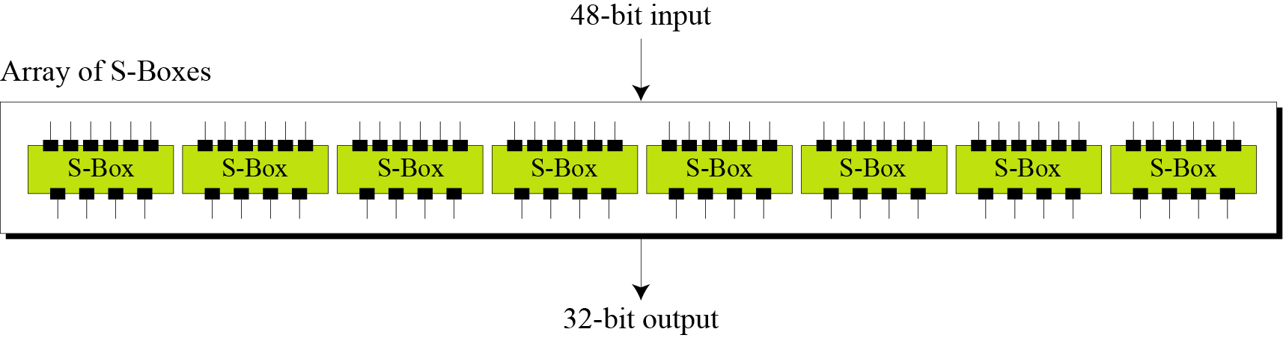
Application of S-Boxes
The S-boxes do the real mixing (confusion --- nonlinearity). DES uses 8 S-boxes, each with a 6-bit input and a 4-bit output.
S_{i}: {0,1}⁶ ⟶ {0,1}⁴

Slide 29
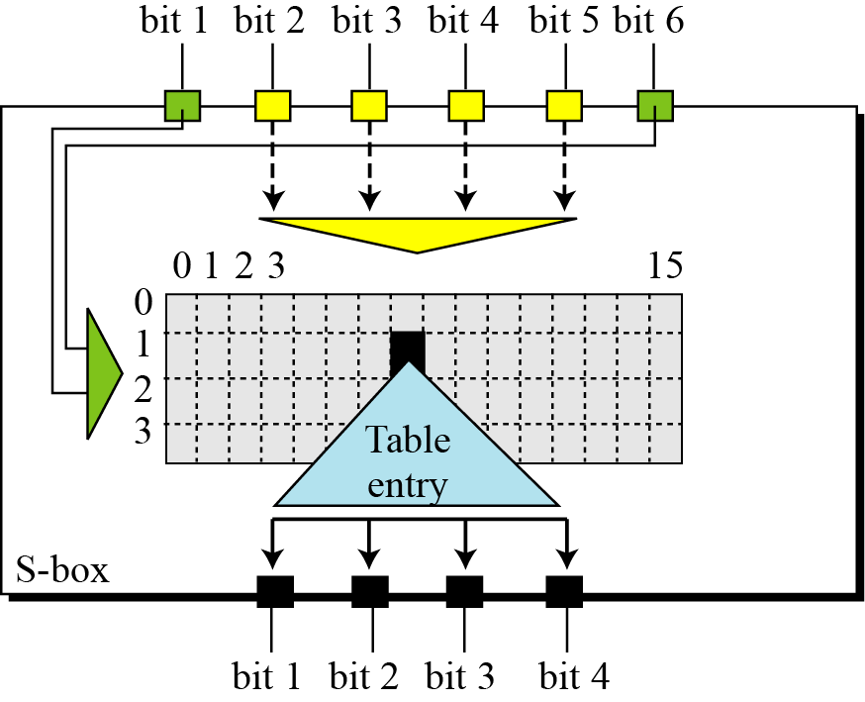
The S-Boxes
S-Box rule

Slide 30
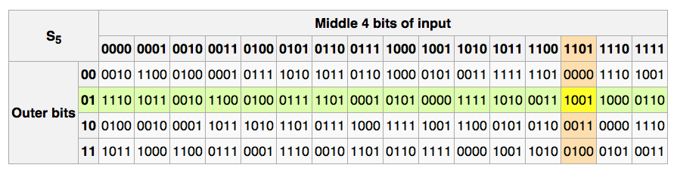
The S-Boxes

Slide 31
Final Straight Permutation on S-Box Output
Straight Permutation Table

Slide 32
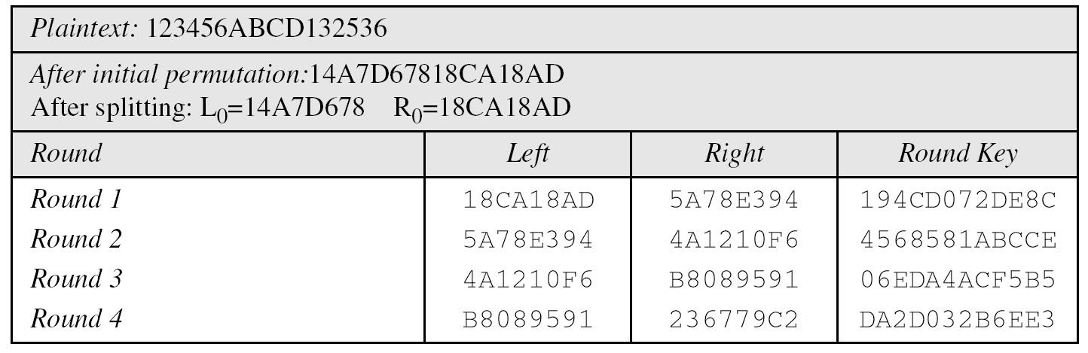
Example
We choose a random plaintext block and a random key, and determine what the ciphertext block would be (all in hexadecimal):
Trace of data for Example

Slide 33
Example (contd)
Trace of data for Example (Conintued

Slide 34
Example (contd)
Let us see how Bob, at the destination, can decipher the ciphertext received from Alice using the same key. Table 6.16 shows some interesting points.

Slide 35
DES Design Criteria
What are the design criteria for the building blocks of the DES algorithm?
This is out of the scope of this course. Interested parties are referred to the following references:
B. Schneier, Applied Cryptography, 2nd Edition, John Wiley & Sons, 1996, pp. 293–294.
D. Coppersmith, The Data Encryption Standard (DES) and Its Strength Against Attacks, IBM Journal of Research and Development, May 1994.

Slide 36
Comments
Security of DES
DES is seen as very secure (except for the key length)
No attacks with lower costs than a Brute Force attack are known as far
There are some so-called weak keys and semi-weak keys
These keys should not be used!
Questions on DES
Design process for DES was not public
Are details well-chosen for strength of the DES algorithm?
Are some weaknesses useful for people involved in the design process?
Are there other weak keys than the known ones?

Slide 37
Choosing the S-boxes and P-box
Choosing the S-boxes and P-box at random would result in an insecure block cipher (key recovery after ≈2²⁴ outputs) [BS’89]
Several rules used in choice of S and P boxes:
No output bit should be close to a linear function of the input bits
Ensure that bits of the output of an S-Box on one round affects the input of multiple S-Boxes in the next round
Two of the output bits of one S-Box should influence the middle of the result, the other two bits should influence the edges
The 4 output bits should form the input of 6 S-Boxes in the next round
⋮

Slide 38
Properties
Two desired properties of a block cipher are the completeness and the avalanche effect.
Completeness effect means that each bit of the ciphertext needs to depend on many bits on the plaintext
Avalanche effect means a small change in either the plaintext or the key should produce a significant change in the ciphertext.
The avalanche effect is in fact a measure of diffusion.
Remark: Linear functions are usually for diffusion.

Slide 39
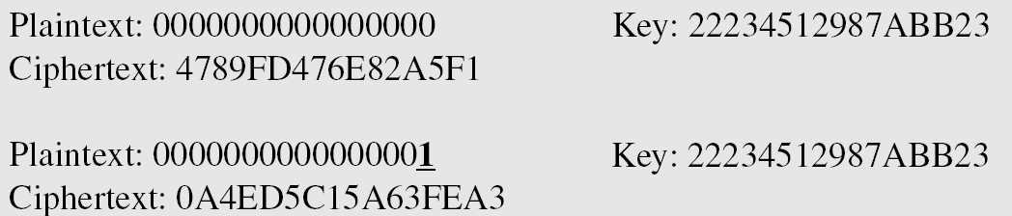
Example of Avalanche Effect
To check the avalanche effect in DES, let us encrypt two plaintext blocks (with the same key) that differ only in one bit and observe the differences in the number of bits in each round.

Slide 40
Example of Avalanche Effect
Although the two plaintext blocks differ only in the rightmost bit, the ciphertext blocks differ in 29 bits. This means that changing approximately 1.5 percent of the plaintext creates a
change of approximately 45 percent in the ciphertext.
Number of bit differences for Example

Slide 41
To Summarize
S-Boxes
The design provides confusion (non-linearity) of bits from each round to the next.
P-Boxes
They provide diffusion of bits.
Number of Rounds
DES uses sixteen rounds of Feistel ciphers. the ciphertext is thoroughly a random function of plaintext and ciphertext.

Slide 42
Security of DES
DES, as the first important block cipher, has gone through much scrutiny. Among the attempted attacks, three are of interest:
Brute-force
Due to the weakness of short cipher key DES can be broken using 2⁵⁵ encryptions.
Differential Cryptanalysis
It has been revealed that the designers of DES already knew about this type of attack and designed S-boxes and chose 16 as the number of rounds to make DES specifically resistant to this type of attack.
Linear Cryptanalysis
Linear cryptanalysis is newer than differential cryptanalysis. DES is more vulnerable to linear cryptanalysis than to differential cryptanalysis. S-boxes are not very resistant to linear cryptanalysis. It has been shown that DES can be broken using 2⁴³ pairs of known plaintexts. However, from the practical point of view, finding so many pairs is very unlikely.
Notes:
Differential CryptAnalysis: how differences in information input can affect the resultant difference at the output.
Linear CryptAnalysis:

Slide 43
Advance Encryption Standard (AES)

Slide 44
The AES process
1997: NIST publishes request for proposal
1998: 15 submissions.
1999: NIST chooses 5 finalists
2000: NIST chooses Rijndael as AES (designed in Belgium)
Key sizes: 128, 192, 256 bits.
Block size: 128 bits
Rounds:
10 rounds of repetition for 128-bit keys.
12 rounds of repetition for 192-bit keys.
14 rounds of repetition for 256-bit keys.
Notes:
Larger the key, more secure, but more slow

Slide 45
AES is a Subs-Perm network (not Feistel)
k_{n}
k₁
k₂
S₁
S₁
S₁
S₂
S₂
S₂
S₃
S₃
S₃
⋯
⨁
⨁
⨁
output
input
⋯
⋯
⋯
S₈
S₈
S₈
subs.
layer
perm.
layer
inversion
Notes:
It’s a Subs-Permutation Network not Feistal
In Feistal half the bits are unchanged
Subs and permutation (bits are shuffled around)
Every Step must be reversible. Remember in DES the S-Box were not reversible as they map 6 to 4 bits.
All the steps are applied in reverse order

Slide 46
High-level Description of AES
KeyExpansion—round keys are derived from the cipher key using Rijndael's key schedule.
http://en.wikipedia.org/wiki/Rijndael_key_schedule
Initial Round
AddRoundKey—each byte of the state is combined with the round key using bitwise xor.
Rounds
SubBytes—a non-linear substitution step where each byte is replaced with another according to a lookup table.
ShiftRows—a transposition step where each row of the state is shifted cyclically a certain number of steps.
MixColumns—a mixing operation which operates on the columns of the state, combining the four bytes in each column.
AddRoundKey
Final Round (no MixColumns)
SubBytes
ShiftRows
AddRoundKey
*source = wiki
Notes:
Larger the key, more secure, but more slow

Slide 47
AES-128 schematic
10 rounds
4
ByteSub
ShiftRow
MixColumn
ByteSub
ShiftRow
MixColumn
ByteSub
ShiftRow
input
⋯
4
⨁
⨁
⨁
⨁
invertible
k₀
k₁
k₂
k₉
⨁
k₁₀
key
output
4
key expansion:
16 bytes
16 bytes ⟶176 bytes
4
Notes:
The plaintext in 16 bytes represented as a 4x4 block
11 keys are generated
We always keep a 4x4 array

Slide 48
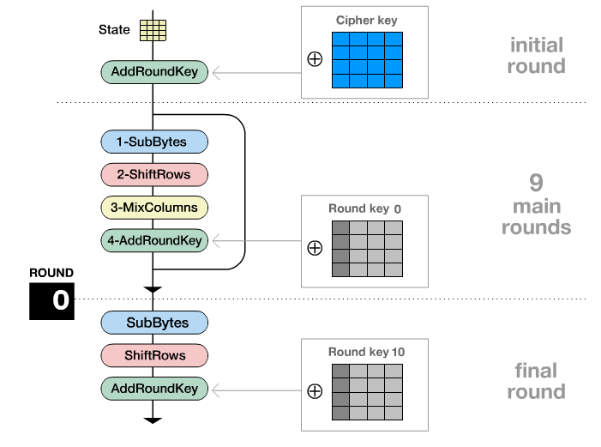
Encryption Process

Slide 49
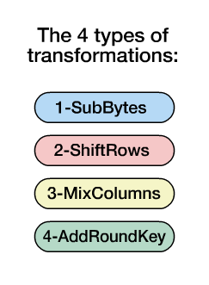
Transformation

Slide 50
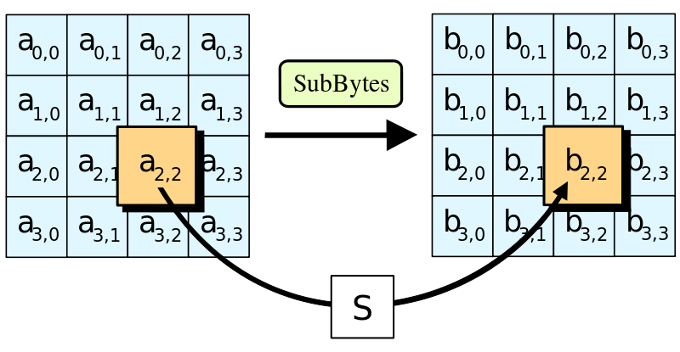
SubBytes
In the SubBytes step, each byte in the state is replaced with its entry in a fixed 8-bit lookup able, S; b_{ij} = S(a_{ij}).
*source = wiki

Slide 51
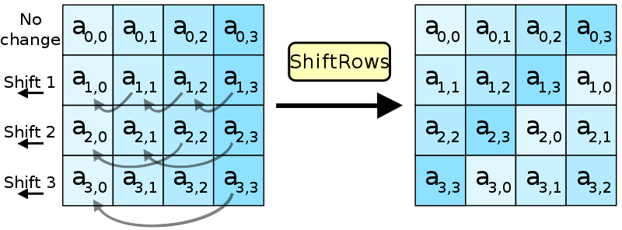
ShiftRows
In the ShiftRows step, bytes in each row of the state are shifted cyclically to the left. The number of places each byte is shifted differs for each row
*source = wiki

Slide 52
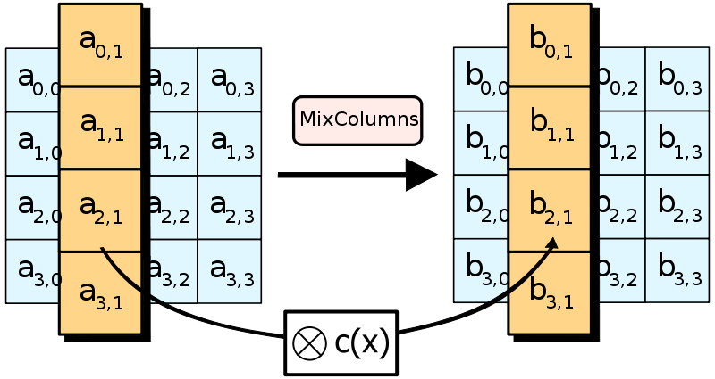
MixColumns
In the MixColumns step, each column of the state is multiplied with a fixed polynomial c(x).
*source = wiki

Slide 53
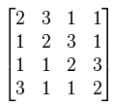
MixColumns
The multiplication operation is defined as:
multiplication by 1 means no change
multiplication by 2 means shifting to the left
multiplication by 3 means shifting to the left and then performing xor with the initial unshifted value.
*source = wiki

Slide 54
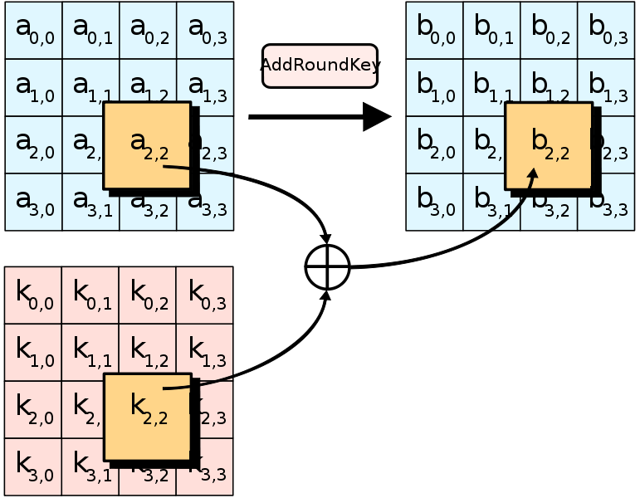
AddRoundKey
In the AddRoundKey step, each byte of the state is combined with a byte of the round subkey using the XORoperation (⊕).
*source = wiki

Slide 55
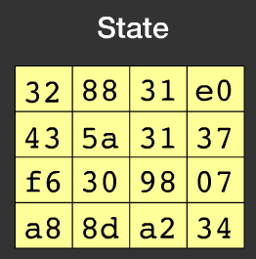
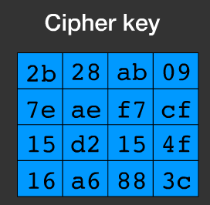
Example (Input)

Slide 56
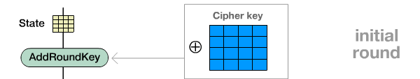
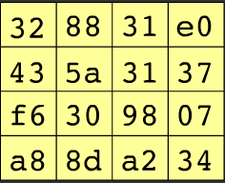
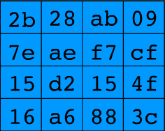
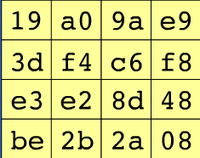


Example (Initial round)

Slide 57
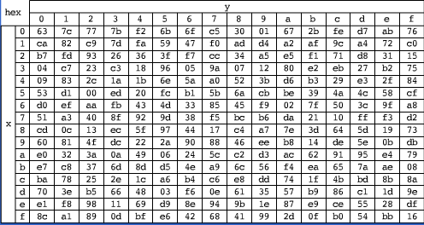
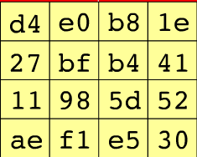
Example (R1-SubBytes)
SubBytes

Slide 58
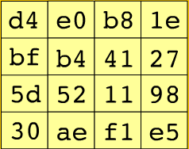
Example (R1-ShiftRows)
ShiftRows

Slide 59
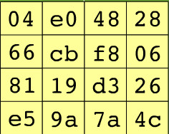
Example (R1-MixColumns)
MixColumns

Slide 60


Example (R1-AddRoundKey)
AddRoundKey

Slide 61
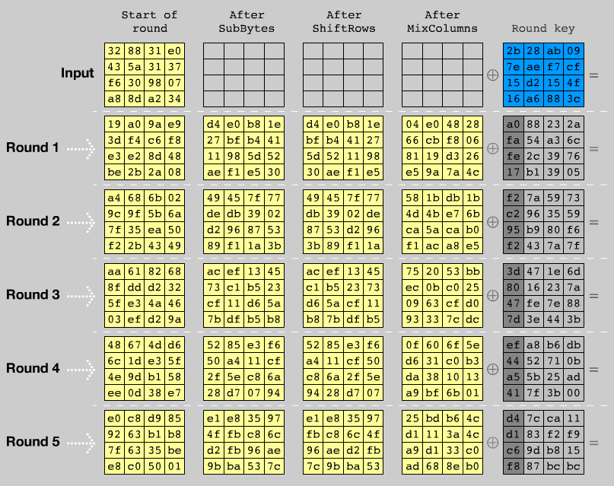

Slide 62
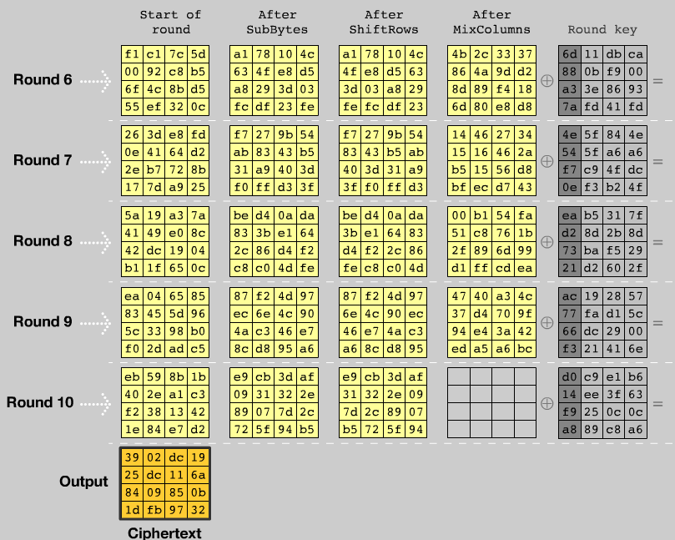

Slide 63
Code size/performance tradeoff
 | Code size | Performance
Pre-compute round functions (24KB or 4KB) | largest | fastest: table lookups and xors
Pre-compute S-box only (256 bytes) | smaller | slower
No pre-computation | smallest | slowest
Notes:
If you can do a lot of pre-computation your speed will increase
If no pre-computation like computing S-boxes on the fly.

Slide 64


Example: Javascript AES
AES in the browser:
AES library (6.4KB)
no pre-computed tables
Prior to encryption: pre-compute tables
Then encrypt using tables
http://crypto.stanford.edu/sjcl/
Notes:
http://crypto.stanford.edu/sjcl/
The browser inflates the implementation and
Shrink the code so there is small traffic in the network
As the code lands on the browser the browser does all the precomputation and code inflates itself.

Slide 65
AES in hardware
AES instructions in Intel Westmere:
aesenc, aesenclast: do one round of AES
128-bit registers: xmm1=state, xmm2=round key
aesenc xmm1, xmm2 ; puts result in xmm1
aeskeygenassist: performs AES key expansion
Claim 14 x speed-up over OpenSSL on same hardware
Similar instructions on AMD Bulldozer
Notes:
To implement AES called aesenc 9 times and then call aesenclast.
AES is such a popular block cipher, Intel has added support AES in the processor. There are specific commands
Aesenc essentially implement one round of AES (3 functions)
Aesenclast implement the last round (remember there is no mix column)

Slide 66
Attacks
Best key recovery attack:
four times better than ex. search [BKR’11]
Related key attack on AES-256: [BK’09]
Given 2⁹⁹ inp/out pairs from four related keys in AES-256 can recover keys in time ≈2⁹⁹
Notes:
Instead of 128bit keys you will be thinking of 126 bits key --- essentially security is not hurt
2^99 is still higher than what we can run today

Slide 67
Performance:
AMD Opteron, 2.2 GHz ( Linux)
Cipher Block/key size Speed (MB/sec)
RC4 126
Salsa20/12 643
Sosemanuk 727
3DES 64/168 13
AES-128 128/128 109
stream
block

Slide 68
One-time and Many-time keys
One-time keys
Adversary’s power:
Adv sees only one ciphertext (one-time key)
Adversary’s goal:
Learn info about PT from CT (semantic security)
Many-time keys
Adversary’s power:
Adv have access to plaintext and its corresponding ciphertext
Adversary’s goal:
Learn info about PT and Key from CT/PT pair (semantic security against chosen/known Plaintext attacks)
Notes:
Today: we build ciphers that are semantically secure against one-time use
And ciphers that are semantically secure against many-time use

Slide 69
Modes of Encryption

Slide 70
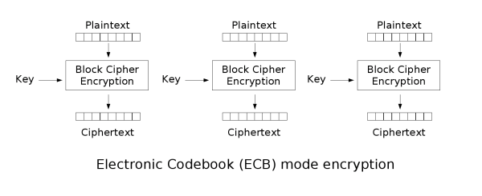
Electronic Codebook (ECB) mode
Simplest method: divide a message into blocks and encrypt each one
Advantage: fast access to single blocks
*image source = wiki (also for several following images)

Slide 71
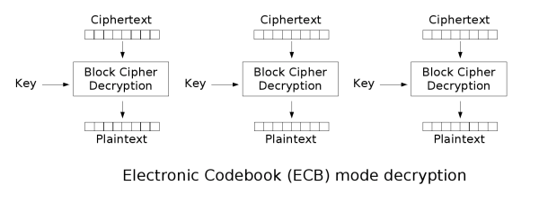
Electronic Codebook (ECB) mode
Does not hide data patterns well and doesn't provide serious message confidentiality
Not recommended for use in cryptographic protocols at all.
Make protocols without integrity protection more susceptible to replay attacks
Each block gets decrypted in exactly the same way.
*image source = wiki (also for several following images)
Notes:
Larger the key, more secure, but more slow

Slide 72


Electronic Codebook (ECB) mode
Disadvantage: Too simple, too dangerous; does not satisfy the requirements
Identical blocks are encrypted to the same cipher block and can be identified by an attacker i.e. if m₁=m₂ then c₁=c₂
The message structure can be identified
If the attacker knows, what context the plaintext has, parts of message can be manipulated
ECB is not semantically secure for messages that contain more than one block.
Original Image
Encrypted using ECB mode
Notes:
Larger the key, more secure, but more slow

Slide 73
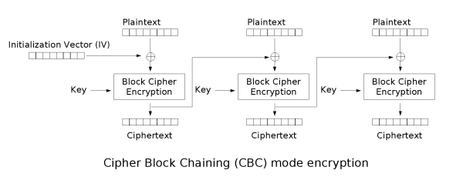
Cipher Block Chaining (CBC) mode
Invented by IBM in 1976
Each block of plaintext is XORed with the previous ciphertext block before being encrypted
Each ciphertext block depends on all plaintext blocks processed up to that point
For Uniqueness, an initialization vector (IV) must be used in the first block.
Mathematical Formula
Notes:
Larger the key, more secure, but more slow

Slide 74
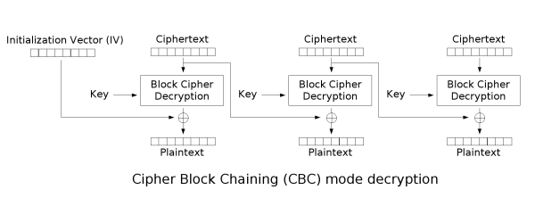
Cipher Block Chaining (CBC) mode
For each message to be encoded, a new IV should be used
Usage of the same IV for all messages would cause some problems:
Differences in similar messages can be found by an attacker
Old messages can be sent by an attacker at a later time
Chosen plaintext can be applied as an attack
Mathematical Formula
Notes:
Larger the key, more secure, but more slow

Slide 75

Cipher Block Chaining (CBC) mode
Drawback(s)
Encryption is sequential (cannot be parallelized).
A one-bit change in a plaintext or IV affects all following ciphertext blocks.
For Decryption Incorrect IV causes only the first block of plaintext to be corrupt
Plaintext block can be recovered from two adjacent blocks of ciphertext
Decryption cannot be parallelized
one-bit change to the ciphertext causes complete corruption of the corresponding block of plaintext
rest of the blocks remain intact.
Original Image
Encrypted using CBC mode
Notes:
Larger the key, more secure, but more slow

Slide 76
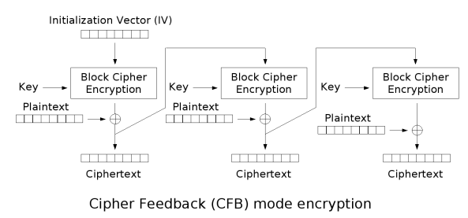

Cipher Feedback (CFB) mode
Close relative of CBC, makes a block cipher into a self-synchronizing stream cipher
Mathematical Formula
Notes:
Larger the key, more secure, but more slow

Slide 77
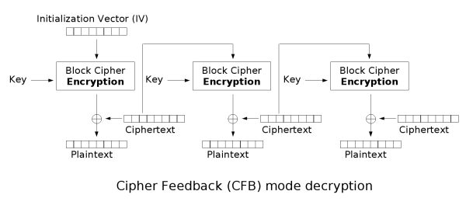
Cipher Feedback (CFB) mode
CFB decryption is almost identical to CBC encryption performed in reverse
Notes:
Larger the key, more secure, but more slow

Slide 78
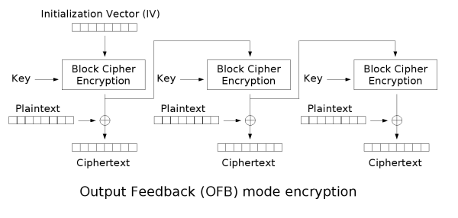
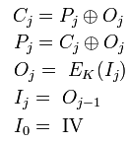
Output Feedback (OFB) mode
Makes a block cipher into a synchronous stream cipher
Just as with other stream ciphers, flipping a bit in the ciphertext produces a flipped bit in the plaintext at the same location
Mathematical Formula
Notes:
Larger the key, more secure, but more slow

Slide 79
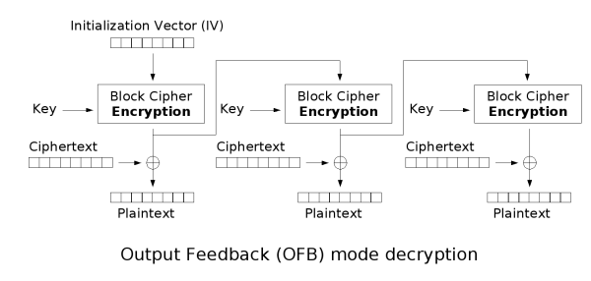
Output Feedback (OFB) mode
Because of the symmetry of the XOR operation, encryption and decryption are exactly the same:
Notes:
Larger the key, more secure, but more slow

Slide 80
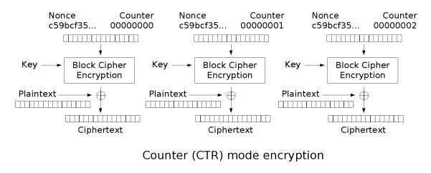
Counter Mode (CTR) mode
Like OFB, counter mode turns a block cipher into a stream cipher
The counter can be any function which produces a sequence which is guaranteed not to repeat for a long time
CTR mode is widely accepted and CBC, CTR modes are recommended by Niels Ferguson and Bruce Schneier
CTR mode is well suited to operate on a multi-processor machine where blocks can be encrypted in parallel
Notes:
Like OFB, counter mode turns a block cipher into a stream cipher. The counter can be any function which produces a sequence which is guaranteed not to repeat for a long time. CTR mode is widely accepted and CBC, CTR modes are recommended by Niels Ferguson and Bruce Schneier.
CTR mode is well suited to operation on a multi-processor machine where blocks can be encrypted in parallel.

Slide 81
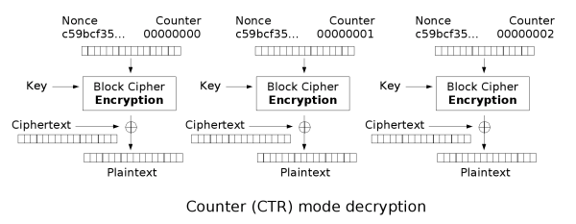
Counter Mode (CTR) mode
Notes:
Larger the key, more secure, but more slow

Slide 82
Acknowledgements
Material in this lecture are taken from the slides prepared by:
Prof. Dan Boneh (Stanford)
Prof. O. Spaniol (RWTH Aachen)

